Slide 1

Unit 1: Lesson 5
Dream team

Slide 2
Open your book, page 20
Task 1: Answer the questions.
Task 2: Read the text and answer the question.
2 Madison thinks teamwork skills are important.

Slide 3
Task 3: Write true (T), false (F) or not given (NG).
T
T
F
NG
F
T
T
NG
F
T
T
T

Slide 4
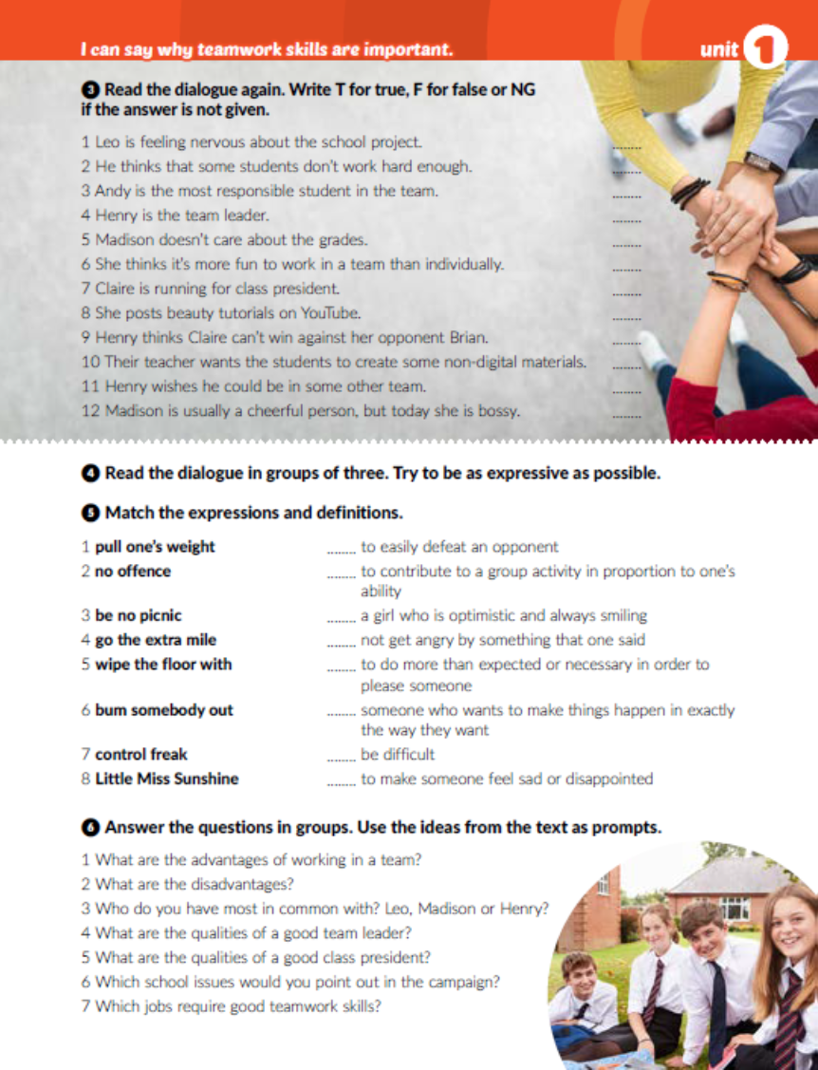
Task 4: Read the text out loud.
Task 5: Match.
5
1
8
2
4
7
3
6

Slide 5

Task 6: Answer the questions.

Slide 6
Open your workbooks, page 16
Task 1: Complete the sentences. Dopuni rečenice ponuđenim riječima.
out
with
on
of
on
out
about
with

Slide 7
No offence
bumming out
Little Miss Sunshine
control freak
is no picnic
pull your weight
gone the extra mile

Slide 8
Task 3: Sort out.
Making your own decisions
Taking responsibility
Managing your time
Taking full credit for the work well done
Faster problem solving
Increasing creativity and innovation
Improving communication skills

Slide 9
Task 4: Do you prefer individual work or teamwork? Why?.
Task 5: Read the notes. Which two students would you choose to be your teammates on a science project about endangeres animals? Why?

Slide 10

Otvori sljedeću poveznicu, te odaberi PLAY AND LEARN!
https://wordwall.net/play/18667/358/282

